Slide 1

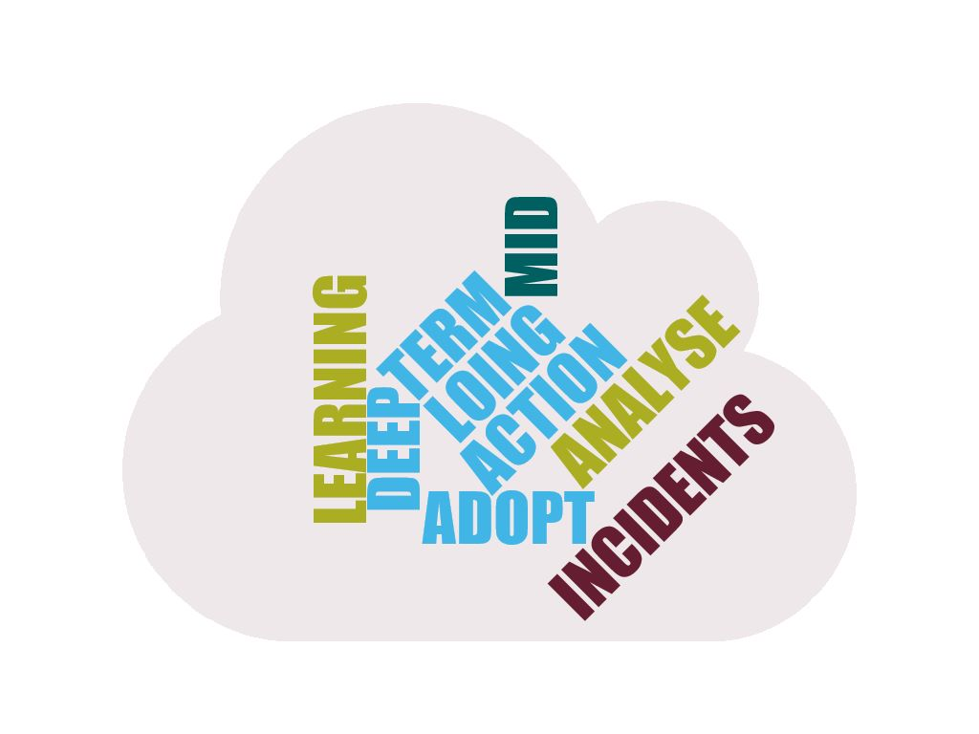






OPERABILITY REVIEW
4 hours every month
SUGGESTED OUTCOME
OPS
NEW PRACTICES
MEETING LEADER(s)
DEVOPS
PRACTICES
INCIDENTS
NEW REQUIREMENTS
Kit
Kit
Kit
ARCHITECTURE
COMMUNITY
FMEA
FRACAS
OPS FITNESS
FUNCTION
NEW ARCHITECTURE BACKLOG
ARCHITECTURE
RUNWAY
GUEST(s)
SUGGESTED WAY OF WORKING
Preparation : Incident review and analysis
TOOLSET
RCA
PSS
FRACAS
ARCHITECTURE RITUALS
-2020.2-

